Slide 1


PowerPoint by Jasper Tu & Ahrenn S.
ZOMBIE
I
C
S
4
U
SIMULATION
MARCO LY, AHRENN SIVANANTHAN, JASPER TU, TYLER ZHANG

Slide 2
CHARACTERS
SCOUT
Sent out from a base to collect supplies & bring them back
Icons above scout will indicate type of supply currently carried
Prioritizes food when base is in desperate need of food; otherwise, will prioritize weapon
ICS4U – ZOMBIE SIMULATION GROUP PROJECT

Slide 3
CHARACTERS
SOLDIER
Spawned by base when it acquires enough weapons
Searches for zombies, aims & shoots at zombies in range
Icon used to indicate whether soldier has ammo or not
Returns back to base, when he runs out of bullets
ICS4U – ZOMBIE SIMULATION GROUP PROJECT

Slide 4
CHARACTERS
ZOMBIE
Comes in from 1 of 4 sides of world; wanders around randomly
Detects human in range - gives chase
Attacks human in contact
If human health runs out - based on zombie’s hunger level, human will either get eaten or turned into 1 of the undead
ICS4U – ZOMBIE SIMULATION GROUP PROJECT

Slide 5
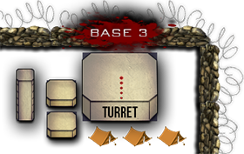
STRUCTURES
BASES [4 in total @ corners of World]
Houses + determines when to spawn soldiers or scouts; has turret firing @ zombies
Population in each base consumes food and reproduces @ given time
If food supply = low … mass spawns scouts to collect supplies, & soldiers to protect scouts
Click on a base; statistics of that base will be shown!
ICS4U – ZOMBIE SIMULATION GROUP PROJECT

Slide 6

STRUCTURES
SUPPLY CRATES
Contain both food & weapons
Number representing type of crate will be randomly generated
When scout obtains a crate - scout can pick up certain # of supplies
When the supplies in a base run out, it will be removed from the screen
ICS4U – ZOMBIE SIMULATION GROUP PROJECT

Slide 7


STRUCTURES
OBSTACLES
Create path blocks for all characters
Harder for zombies to catch up to humans; harder for soldiers + scouts to perform duties
Simulation = more fun to watch ☺
ICS4U – ZOMBIE SIMULATION GROUP PROJECT

Slide 8
ICONS
FOOD ICON
Represents when scout is carrying food back to base
Follows instance of scout they are paired with
Useful class to help visualize hunger situation in each base
Pizza is love, pizza is life … no duh …
ICS4U – ZOMBIE SIMULATION GROUP PROJECT

Slide 9
ICONS
WEAPONS ICON
Represents when scout is carrying weapons back to base
Follows instance of scout they are paired with
Useful class to help visualize what weapon situation is in each base & whether to expect soldiers or not
Guns don’t kill people … I kill people.
ICS4U – ZOMBIE SIMULATION GROUP PROJECT

Slide 10
ICONS
AMMUNITION ICON
Signifies that a soldier still has ammunition remaining
Will disappear when a soldier runs out of ammunition
Get a 9mm they said. You can always find a 9mm they said.
ICS4U – ZOMBIE SIMULATION GROUP PROJECT

Slide 11

MORE FUN STUFF
PLANE
Flies across world when there’re no supplies on screen; drops supplies.
Also shoots down zombies with turrets
Mainly for animation purposes
Provides visual aid of realistic zombie simulation
ICS4U – ZOMBIE SIMULATION GROUP PROJECT

Slide 12

MORE FUN STUFF
Parachute
Has supply crates attached
Size of parachute slowly shrinks as supply reaches closer to ground; parachute then disappears
Meant for visual appeal
ICS4U – ZOMBIE SIMULATION GROUP PROJECT

Slide 13
MORE FUN STUFF
Turret
Bullets
Attached to top of each base & plane wings
Detect zombie in range; rotates to aim and shoot
Fired from turrets & soldiers’ guns
Damages zombies on impact
Cannot penetrate buildings & obstacles
ICS4U – ZOMBIE SIMULATION GROUP PROJECT

Slide 14
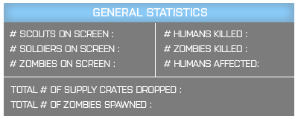
STATISTICS BARS
GENERAL STATISTICS
Has statistics about actors on screen; ex. # of scouts, zombies, & soldiers on screen, & # of each that are dead / alive
States # of supply crates dropped and zombies spawned
Will be half-transparent until clicked
ICS4U – ZOMBIE SIMULATION GROUP PROJECT

Slide 15
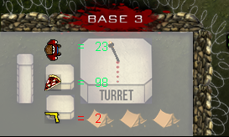
STATISTICS BARS
BASE STATISTICS
Shows statistics for individual bases
Info includes population, food, & weapons in base
Set to be invisible until clicked
ICS4U – ZOMBIE SIMULATION GROUP PROJECT

Slide 16
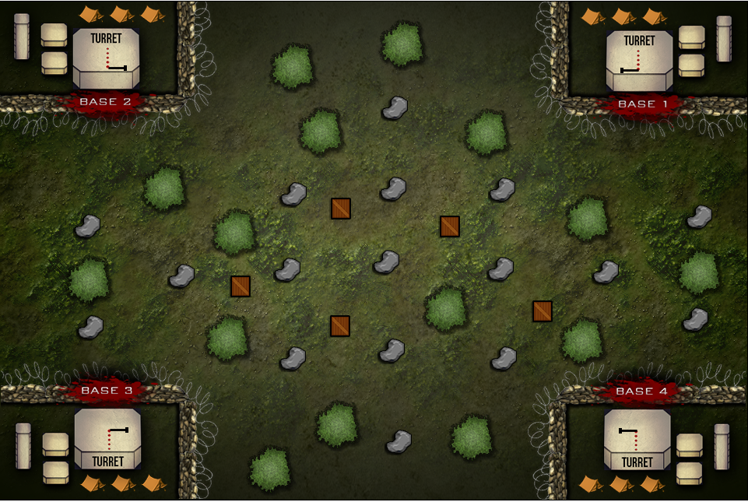
SCREENCAPS
Default world, no characters
ICS4U – ZOMBIE SIMULATION GROUP PROJECT

Slide 17
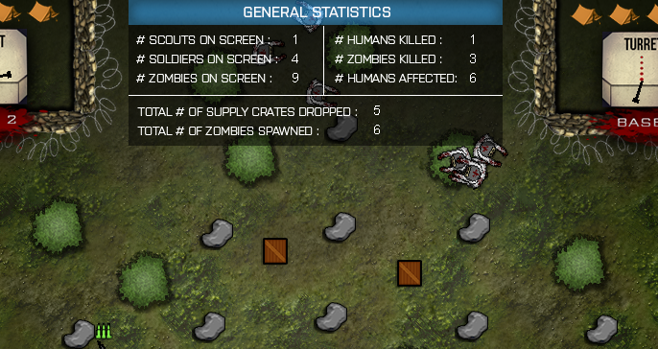
SCREENCAPS
Info getting updated in both Statistics Bars …
ICS4U – ZOMBIE SIMULATION GROUP PROJECT

Slide 18
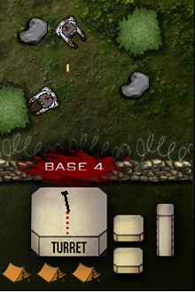
SCREENCAPS
Turret attempts to kill both zombies on screen …
ICS4U – ZOMBIE SIMULATION GROUP PROJECT

Slide 19



SCREENCAPS
Characters with icons above heads …
ICS4U – ZOMBIE SIMULATION GROUP PROJECT

Slide 20
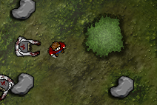
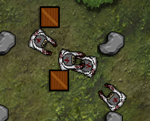
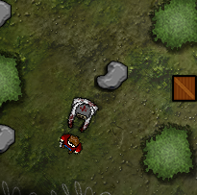
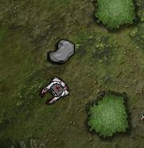
SCREENCAPS
SCOUTS BEING CONVERTED INTO ZOMBIES, & SCOUTS BEING EATEN
ICS4U – ZOMBIE SIMULATION GROUP PROJECT

Slide 21
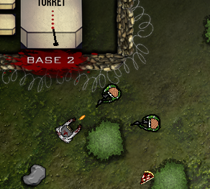
SCREENCAPS
Soldier shoots at zombie …
ICS4U – ZOMBIE SIMULATION GROUP PROJECT

Slide 22
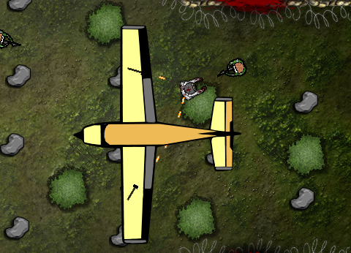


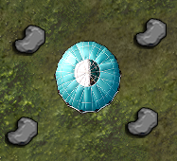
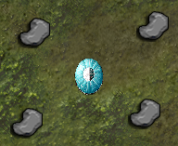
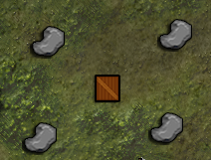
SCREENCAPS
PLANE FLIES OVER, DROPS A PARACHUTE, WHILST SHOOTING @ ZOMBIES
ICS4U – ZOMBIE SIMULATION GROUP PROJECT

Slide 23




SCREENCAPS
SCOUTS & SOLDIERS AVOID OBSTACLES
ICS4U – ZOMBIE SIMULATION GROUP PROJECT

Slide 24
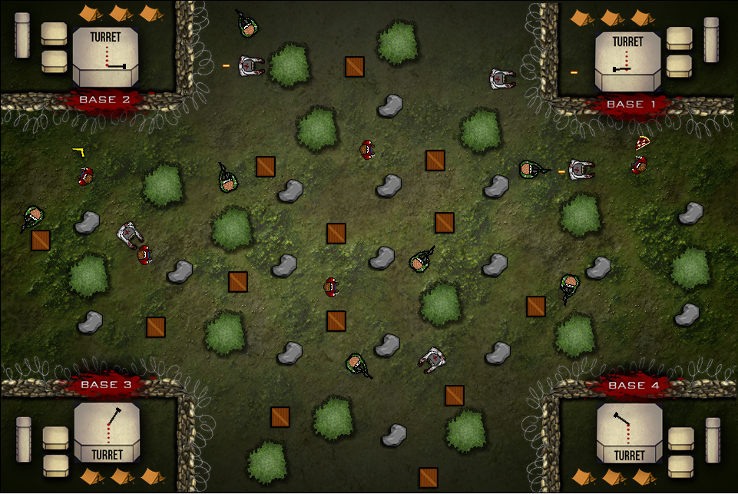
SCREENCAPS [End Result]
ICS4U – ZOMBIE SIMULATION GROUP PROJECT

Slide 25
Elements of OOP
PROCESS (+)
PRODUCT (+)
Clear modular structure
Implement code from a super class multiple times into subclasses
Proper coding conventions (encapsulation) through abstract & protected methods
Modify existing code with ease
Good foundation for code so that all programmers could understand code
Time was saved
Collective group goals were met through using OOP
ICS4U – ZOMBIE SIMULATION GROUP PROJECT

Slide 26
API
PROCESS (-)
PRODUCT (+)
Offered clarity of each class
Allowed for unifying of code; ex. Implementing method to return to base in both a scout and base class
However, still time-consuming when done correctly
Consumed more time that could have been devoted to code quality
Understood its usefulness in real-life scenario through success in coding as group
Great practice for programming in workforce
ICS4U – ZOMBIE SIMULATION GROUP PROJECT

Slide 27
CLASS DIAGRAMS
PROCESS (-)
PRODUCT (+)
Benefit of clear visual model to abide by and double check code (blueprint)
Aided in analysis of interaction before coding commenced
However, was time-consuming to confirm ideas; many were omitted in end result
Worth it in the end, as all group members were able to comprehend each other’s code
Success
ICS4U – ZOMBIE SIMULATION GROUP PROJECT

Slide 28
Thanks for being an Awesome Audience ☺
ICS4U – ZOMBIE SIMULATION GROUP PROJECT

